Slide 1
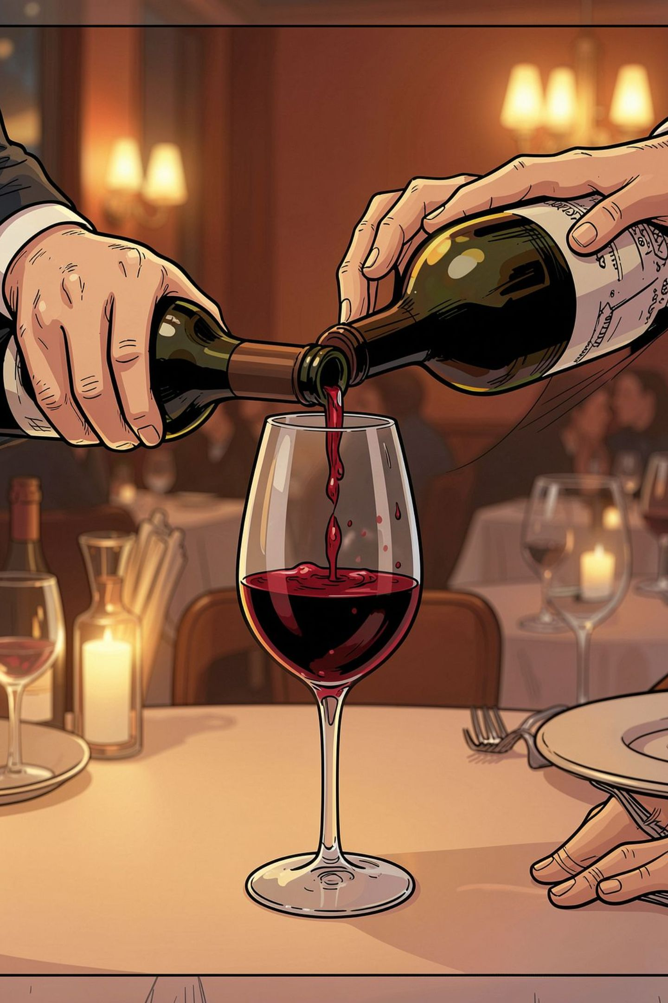
Wine Pouring for Beginners
Wine pouring is a core skill of professional table service. Your goal: serve confidently, avoid spills, control portion size, and create a pleasant guest experience. Handle the bottle with confidence, care, and a professional demeanor — that's the golden rule.

Slide 2
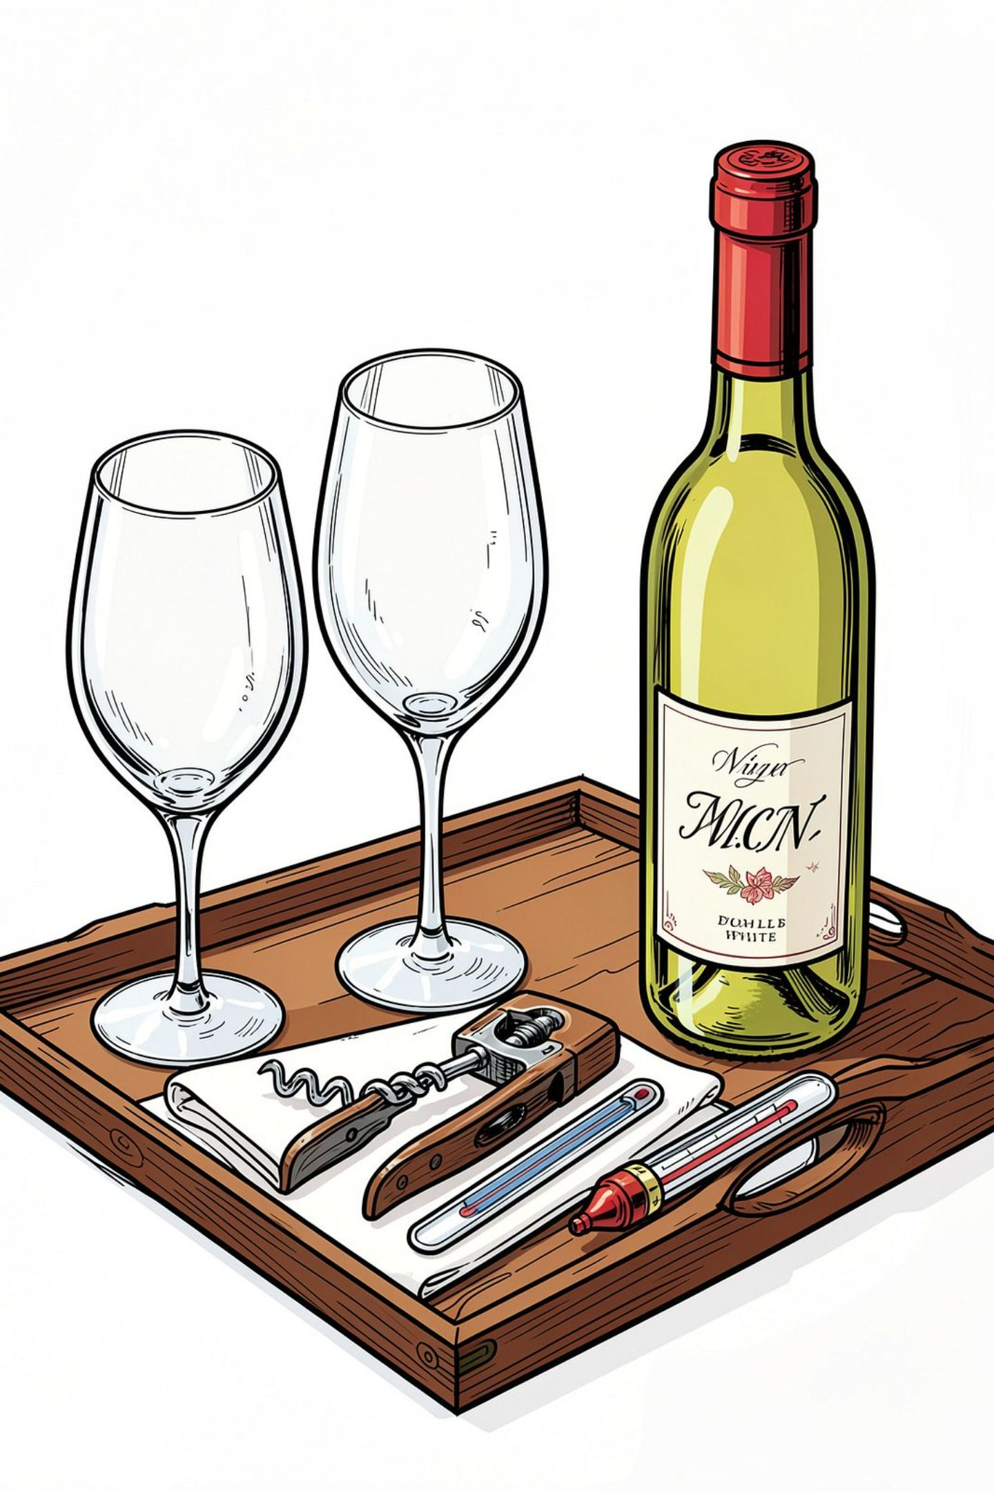

Before You Pour — Mise-en-Place
Essentials
Check the Bottle
Polish & Prep
Correct bottle, clean glasses, corkscrew, service cloth.
Glasses should be spotless; have a clean cloth ready for the neck and lip.
Confirm name, vintage, label condition, temperature, and any leaks or damage.
Good pouring starts before the bottle is opened — preparation reduces mistakes.

Slide 3
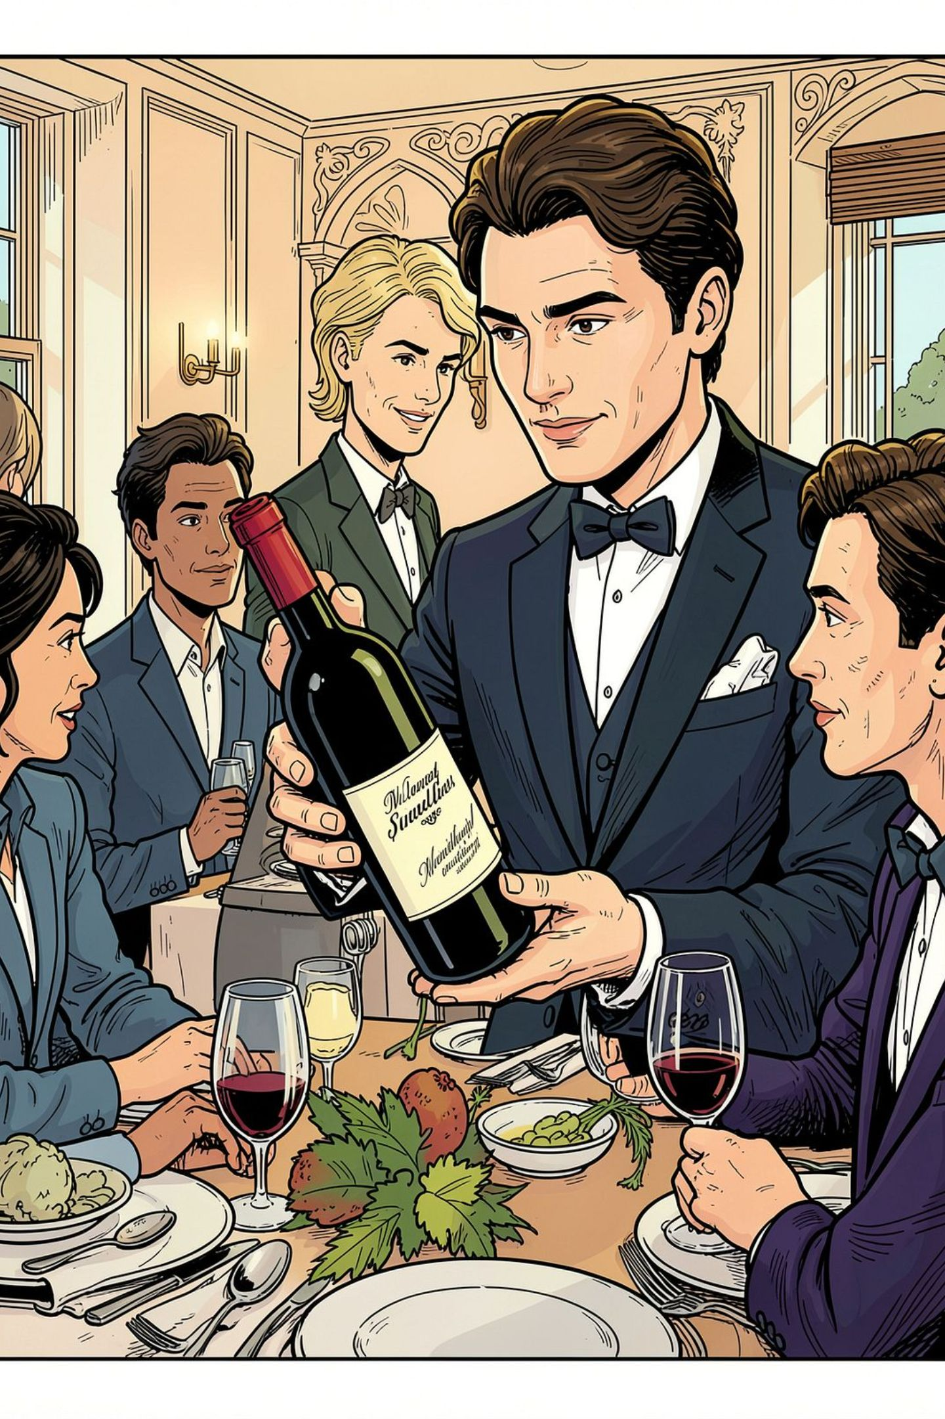
Presenting the Wine
Present the bottle to the guest with the label facing them. Hold the bottle by the body or lower part and announce the wine name and vintage. Allow the host or ordering guest to confirm before you open it. Never obscure the label during presentation — transparency builds trust.
01
02
Hold
Show
Body or lower bottle — steady grip.
Label facing guest; state name & vintage.
03
Confirm
Wait for guest approval before opening.

Slide 4
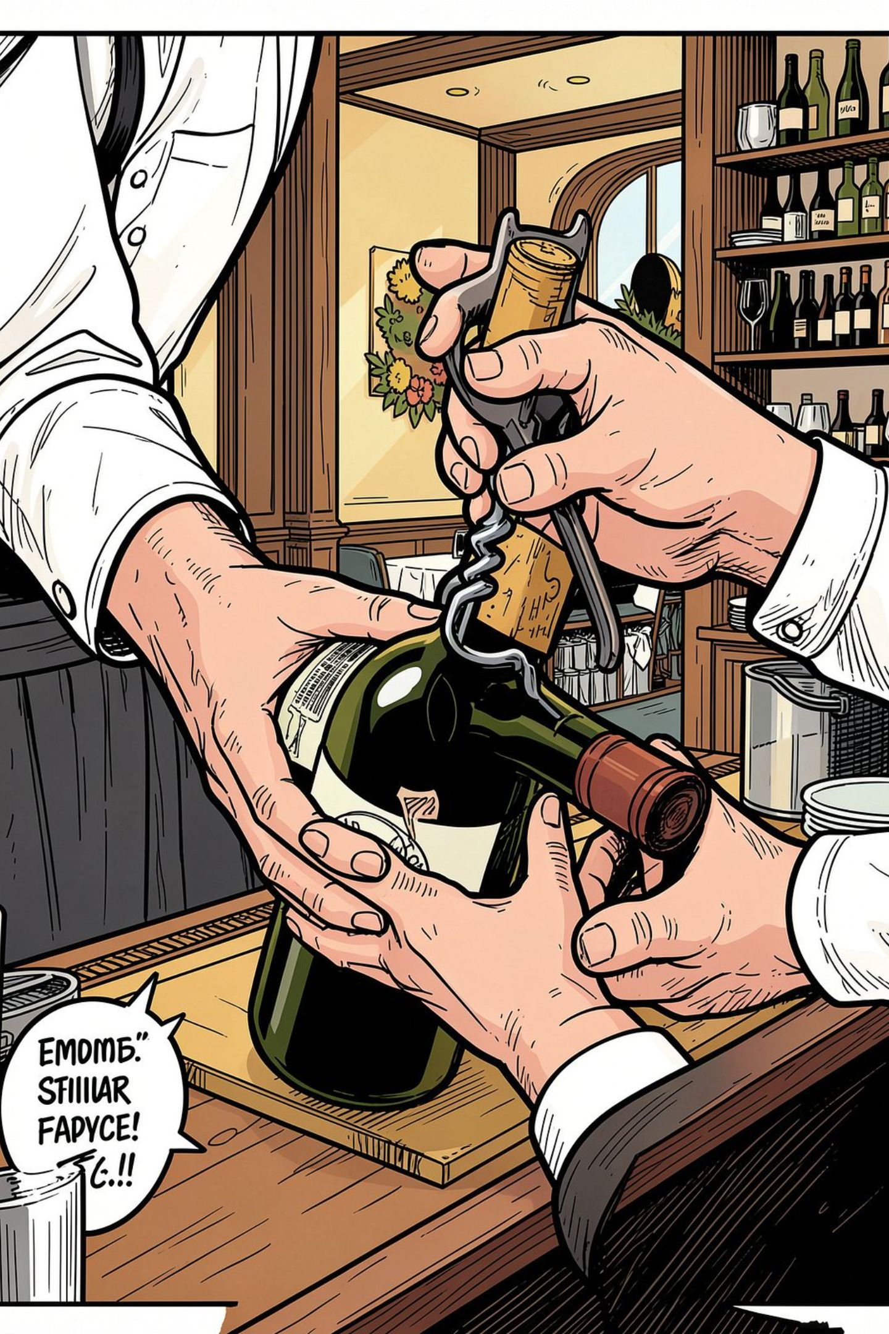

Opening a Still Wine — Step-by-Step
Place the bottle securely on a flat surface or hold steadied at an angle.
Cut the capsule neatly below the lip and remove it cleanly.
Wipe the bottle neck with a clean cloth to remove dust or residue.
Insert the corkscrew straight into the cork; extract smoothly without jerks.
Inspect the cork for faults (mold, crumbly texture, off-odors).
Wipe the neck again after removal to catch any debris or droplets.
For beginners: avoid a loud pop; smooth, quiet openings feel more professional.

Slide 5
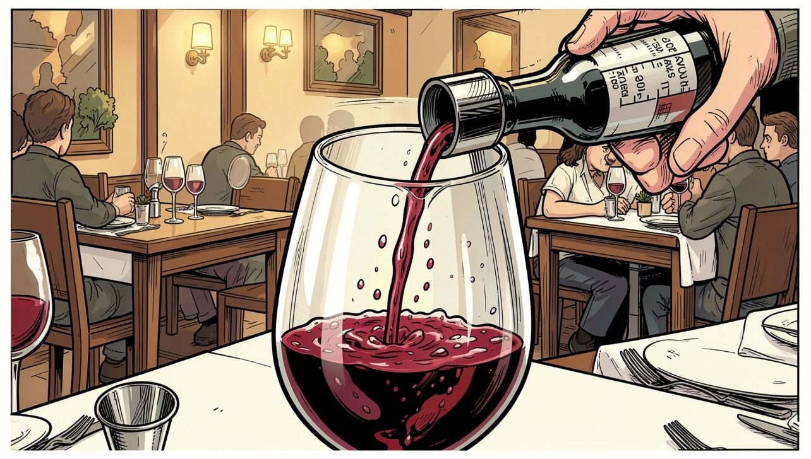
The Correct Pour
A standard serving is about 150 ml (varies by venue). Pour slowly, aiming for the centre or side of the glass. Keep the label visible, never touch the glass with the bottle, and stop before the glass looks too full. At the end of the pour, twist the bottle slightly to prevent drips and lift smoothly.
Hold the bottle firmly — control the flow
Pour slowly & steadily — avoid splashes
Do the finishing twist to stop drips
Use a measuring pour for training until you can judge portions by eye.

Slide 6
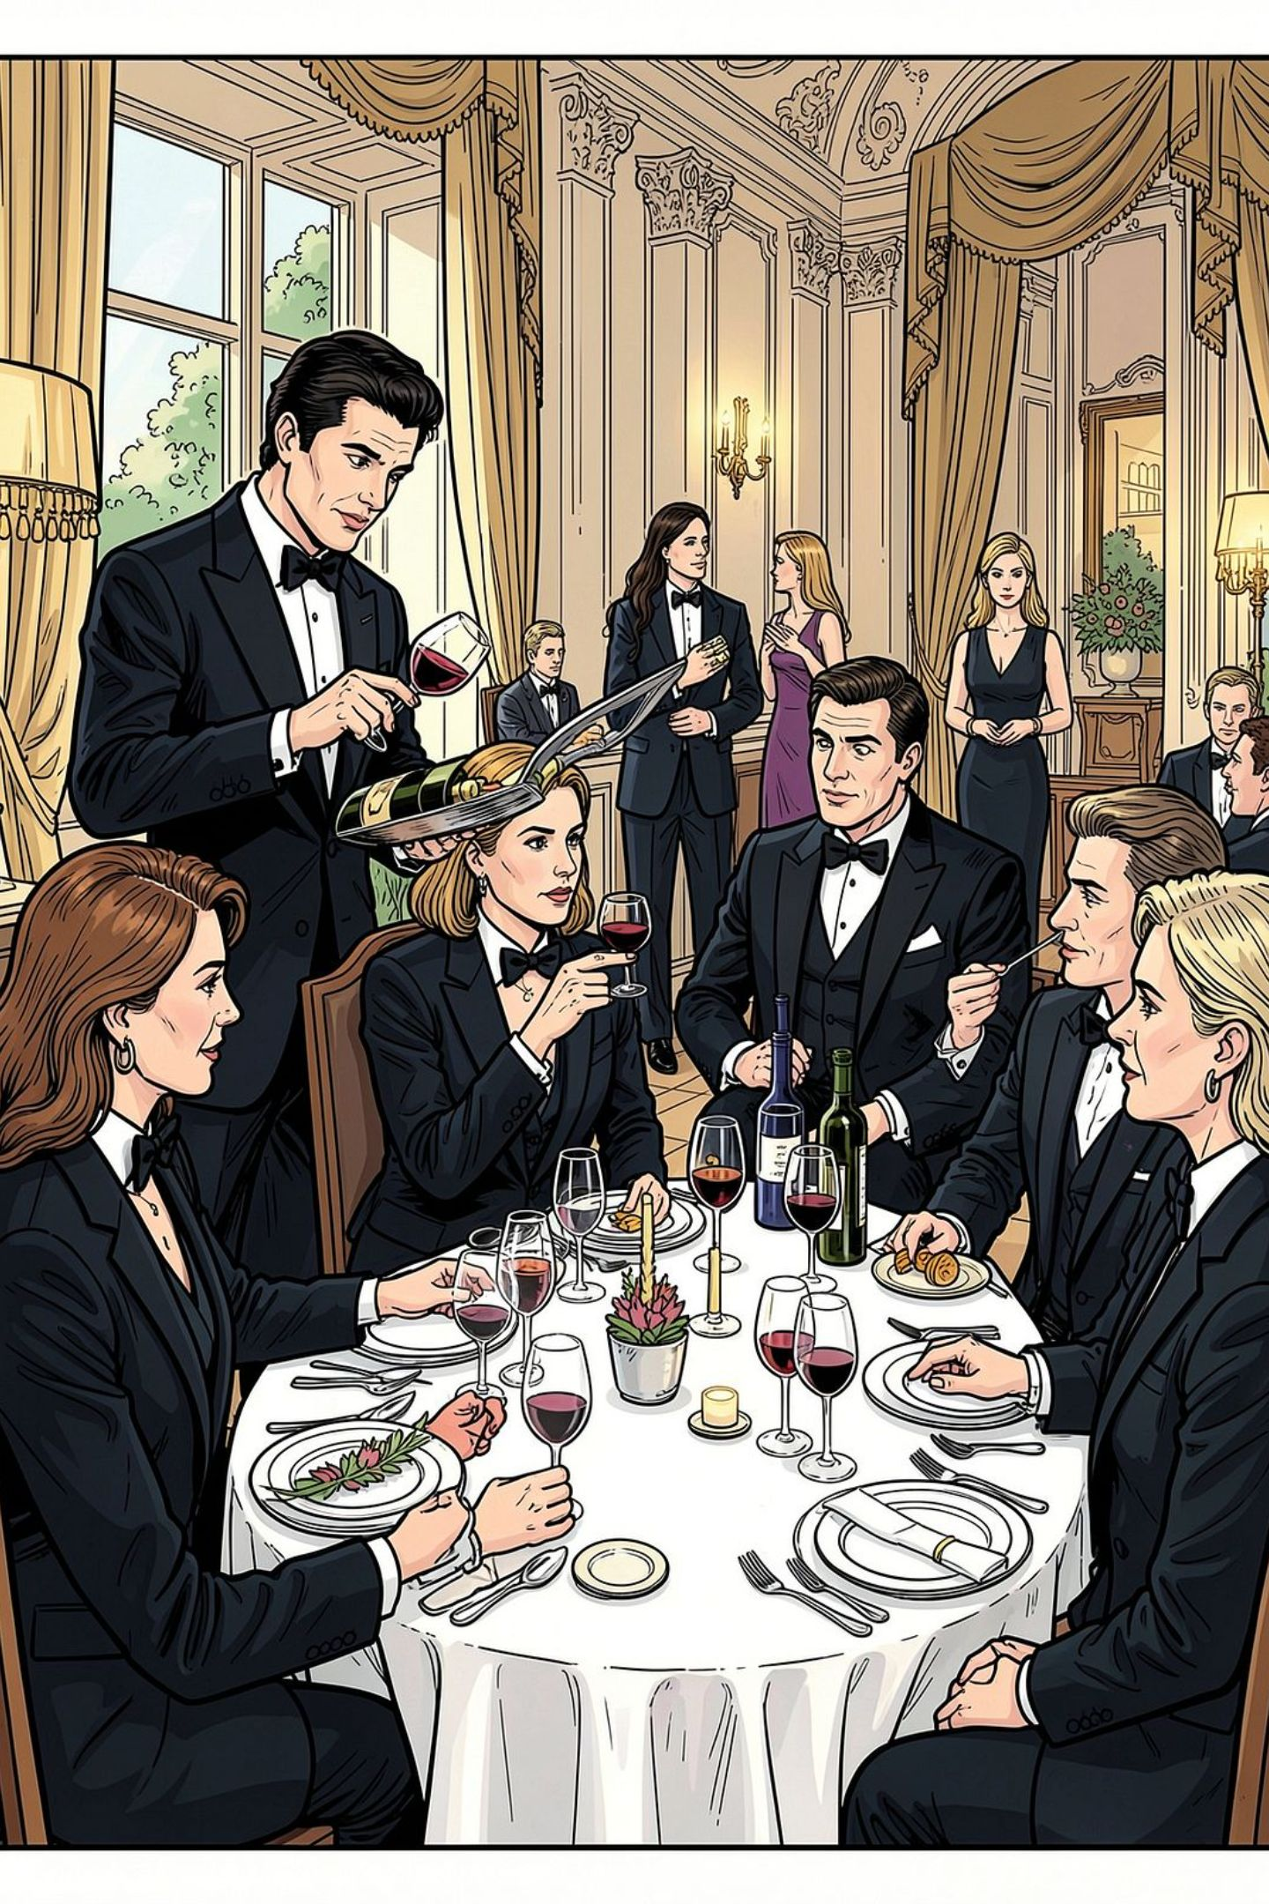
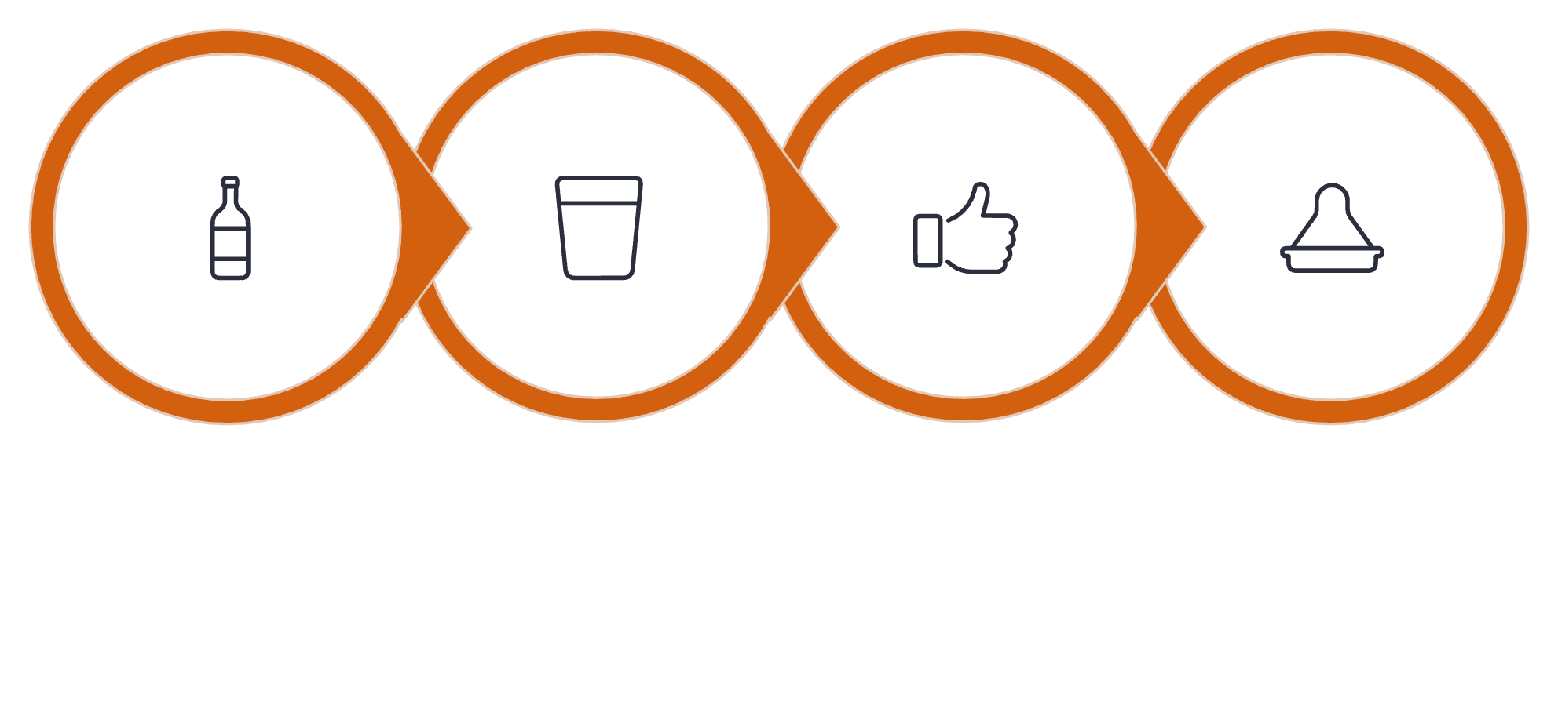
Correct Pouring Sequence — Who to Serve First
In formal service follow: Present → Open → Taste (host) → Approve → Serve guests → Host served last. Offer a small tasting pour to the host who ordered the bottle and wait for approval. After approval, proceed clockwise around the table, finishing by serving the host. Remember to adapt to your restaurant's SOP when needed.
Present Bottle
Offer Tasting
Host Approves
Serve Guests
This simple flow keeps service polite, clear, and guest-focused.

Slide 7
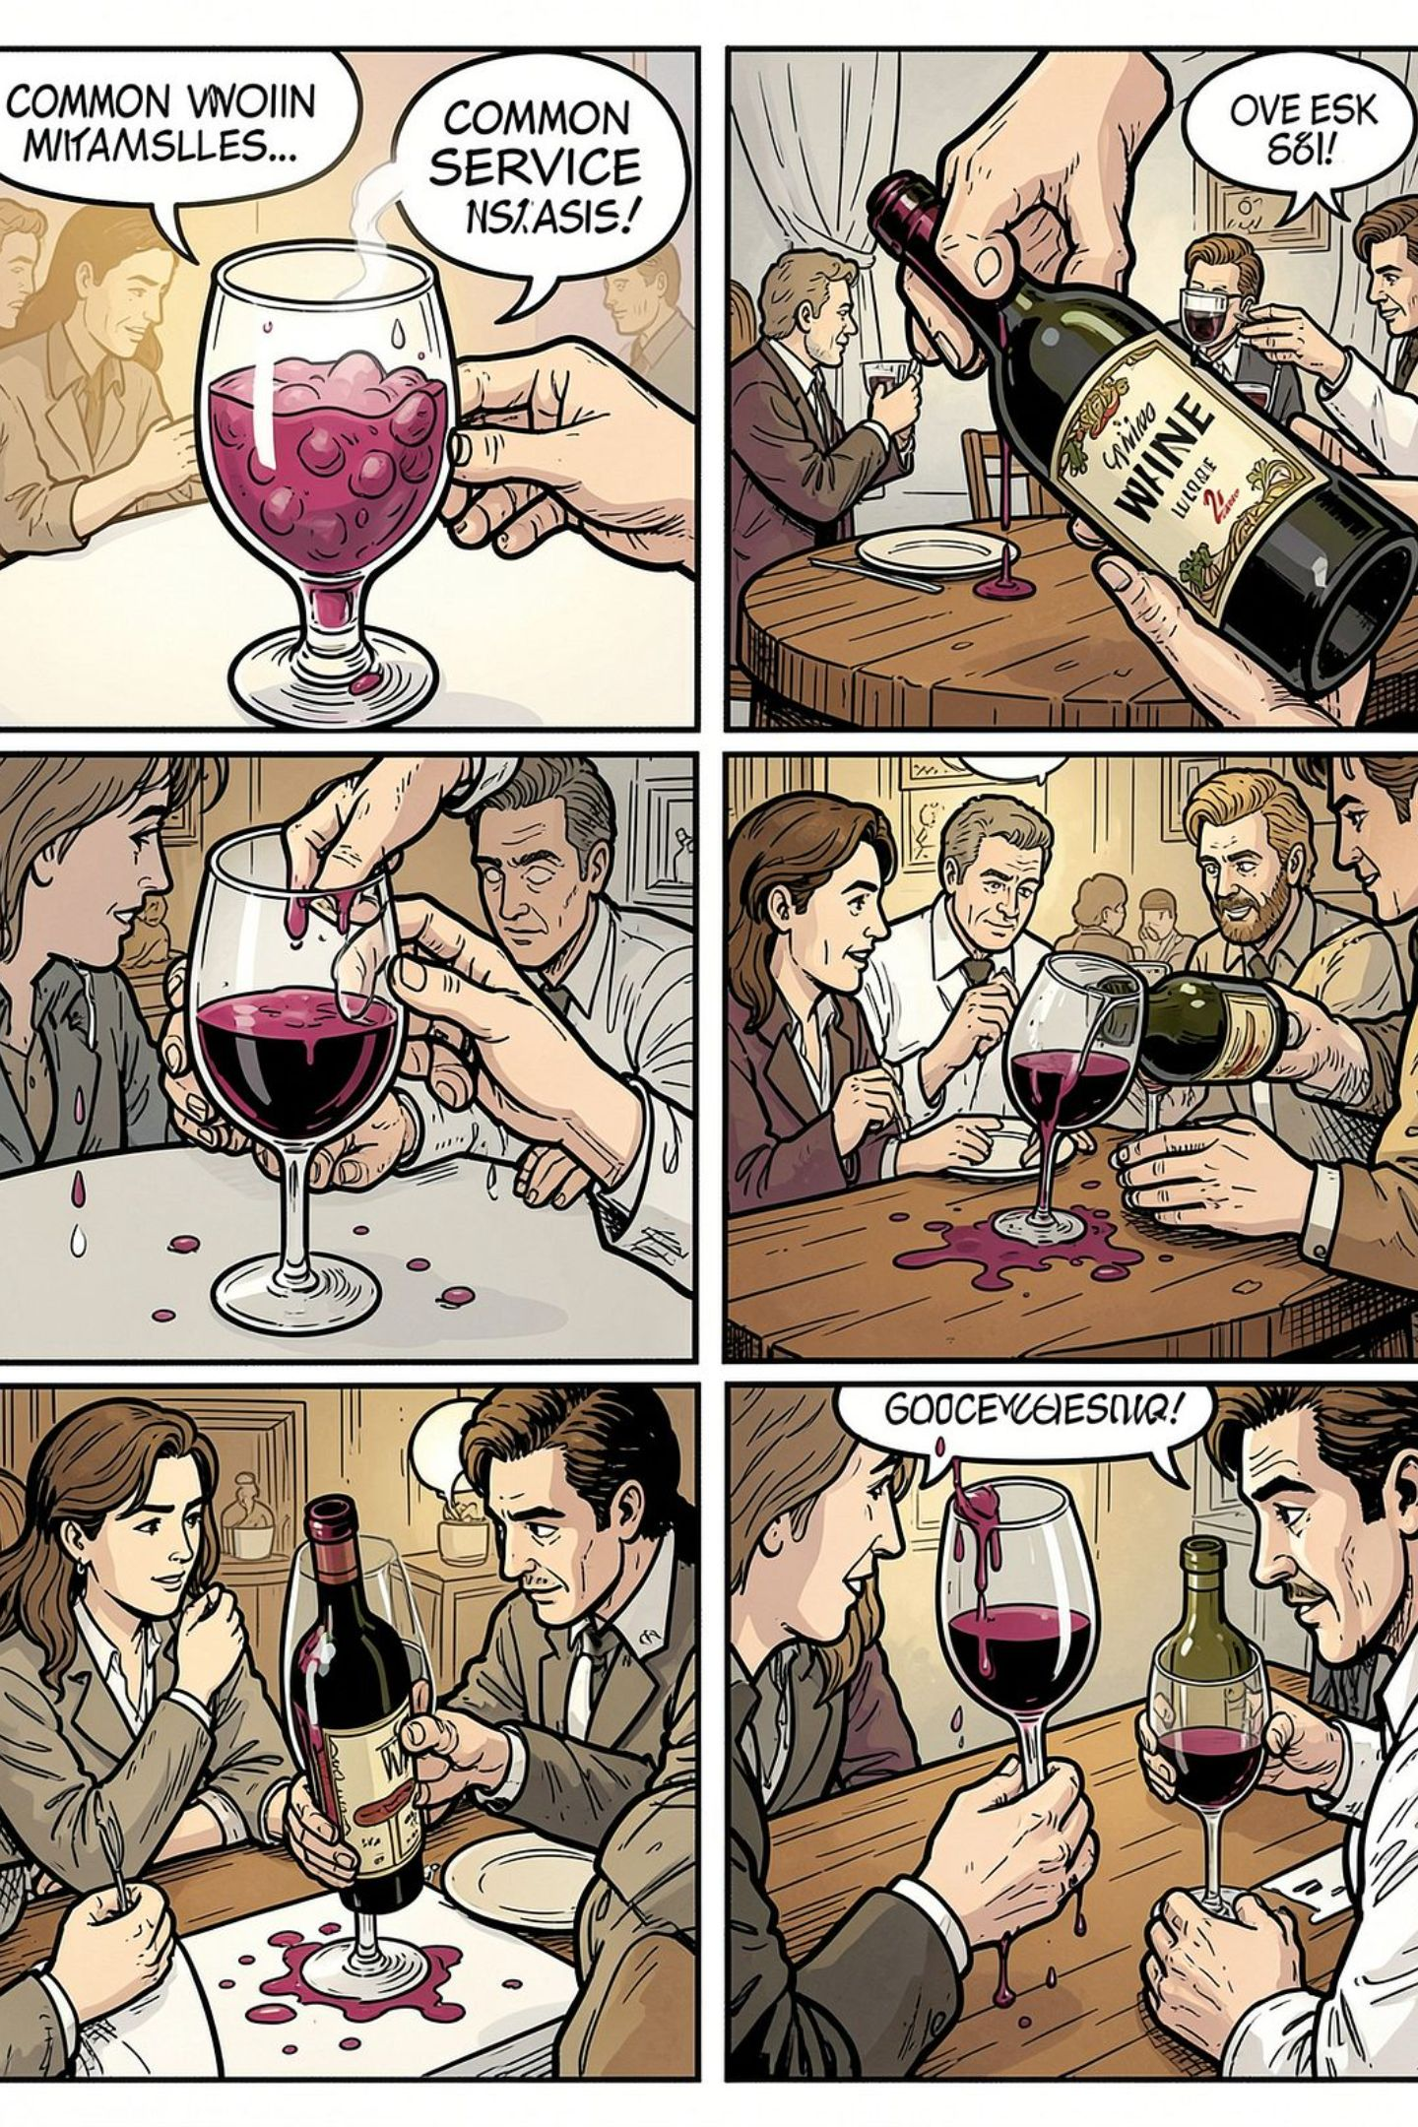




Common Mistakes & How to Avoid Them
Overfilling
Stop before the glass looks crowded — guests need room to swirl.
Touching the Glass
Never let the bottle touch the glass rim — it's unsanitary and unprofessional.
Hiding the Label
Keep the label visible when presenting and pouring — transparency matters.
Drips & Spills
Use the twist at the end and a service cloth to catch any last drops.
Professional standard: Smooth • Controlled • Clean • Confident.

Slide 8

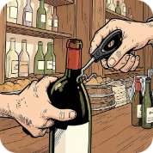
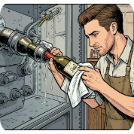
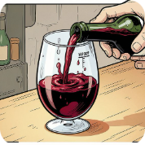

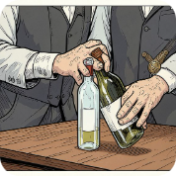

Practical Activity — Practice Checklist
Presenting
Opening
Wiping
Pouring & Twist
Demonstrate label display and verbal confirmation.
Practice clean capsule cuts and smooth cork extraction.
Always wipe before and after uncorking to remove debris.
Use measured pours, finish with a twist to prevent drips.
Service Sequence
Clearing
Follow the proper guest order — host tastes, guests served, host last.
Clear bottles professionally and keep the table tidy.
Practice these steps until they become second nature — skillful pouring builds guest trust and upsells confidence.
Remember: "Don't just pour wine — provide wine service."

